Slide 1

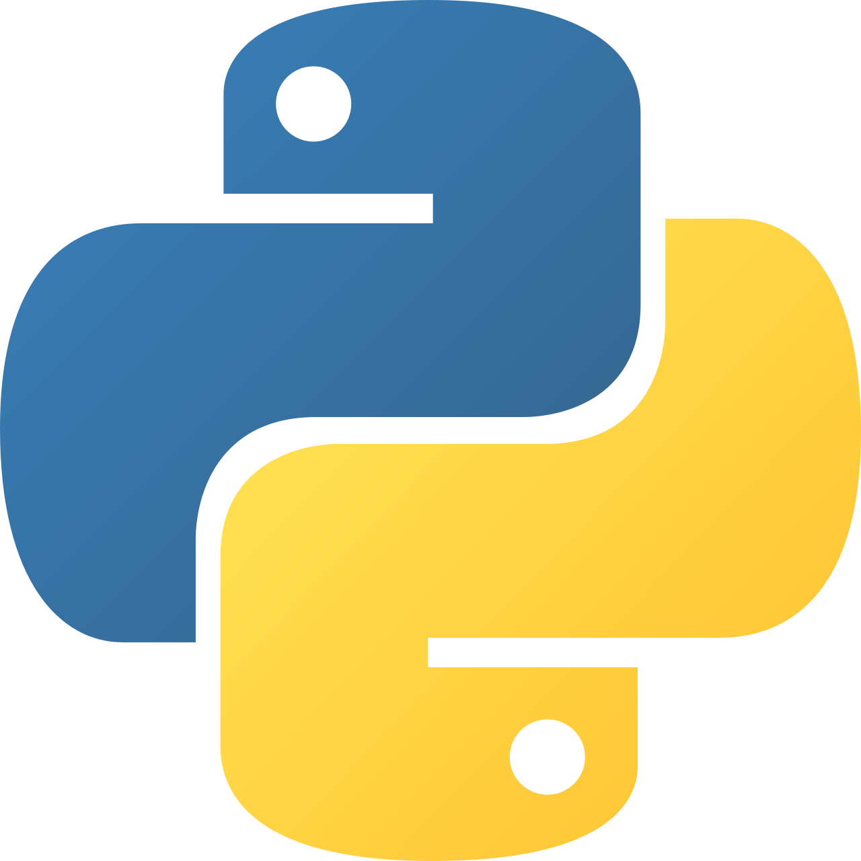
Intermediate Python
Designing with classes

Slide 2
Is-a vs Has-a Relationships
Choosing between inheritance and composition defines your class design quality.
Is-a implies inheritance (Student is a Person)
Has-a implies ownership (Car has an Engine)
Is-a creates strong coupling
Has-a provides more flexibility
Wrong choice leads to rigid designs
Notes:
Teach students to pause before inheriting. Ask: “Is this truly the same thing, or does it just use it?” Overusing inheritance is one of the most common OOP mistakes.

Slide 3
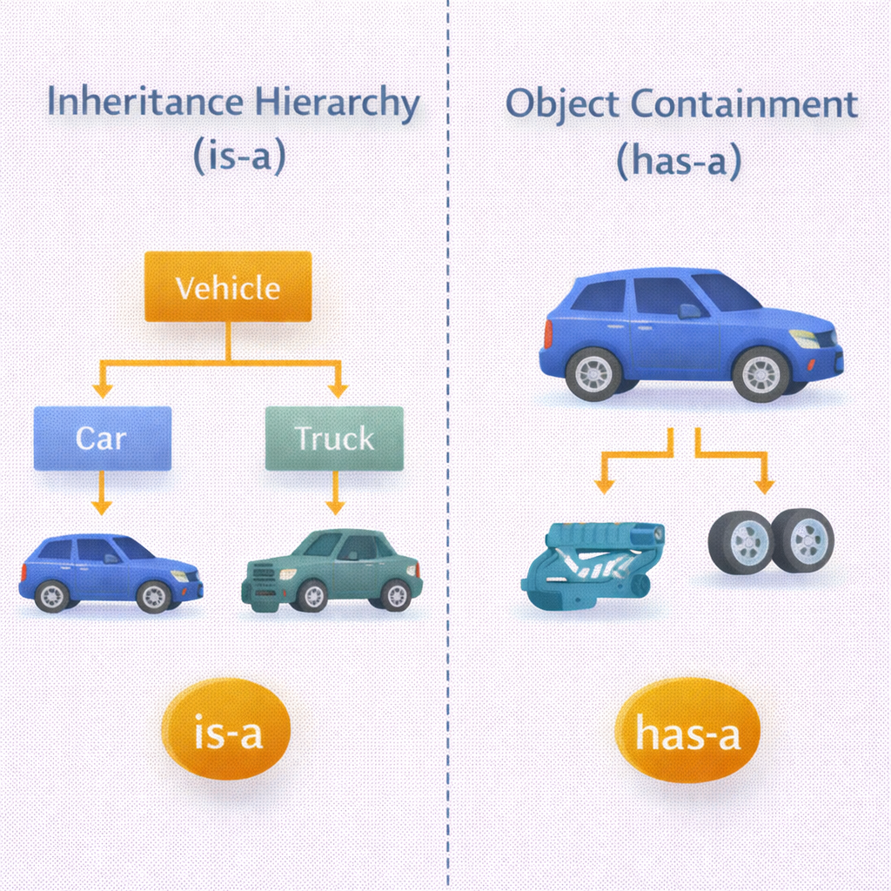

Slide 4
Example Python Code
# Has-a relationship
class Engine:
def start(self):
print("Engine started")
class Car:
def __init__(self):
self.engine = Engine()
def drive(self):
self.engine.start()
# Is-a relationship
class Person:
def speak(self):
print("Person speaking")
class Student(Person):
pass

Slide 5
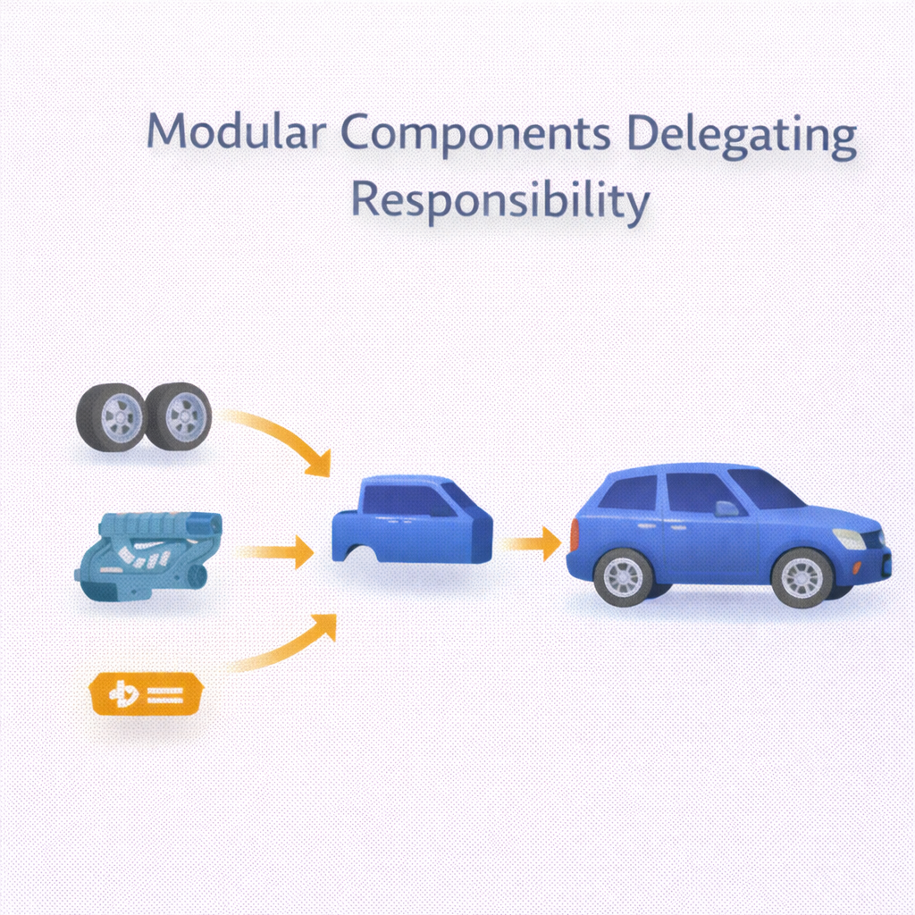
Composition & Delegation
Composition builds objects from smaller parts and delegates responsibility.
Objects are composed of other objects
Behavior is delegated, not inherited
Encourages loose coupling
Easier to change implementations
Preferred over inheritance in many cases
Notes:
Explain that OfficeWorker does not know how to print. It delegates printing to another object. This design scales better and reduces inheritance chains.

Slide 6
Example Python Code
class Printer:
def print_doc(self):
print("Printing document")
class OfficeWorker:
def __init__(self):
self.printer = Printer()
def print_report(self):
self.printer.print_doc()

Slide 7

Mix-ins
Mix-ins add reusable behavior without defining full object identity.
Mix-ins provide small, focused features
Not meant to stand alone
Used with multiple inheritance
Avoid storing state in mix-ins
Common for logging, permissions, utilities
Notes:
Stress that mix-ins are capabilities, not entities. They answer “what can it do?” not “what is it?”. Keep mix-ins small and behavior-focused.

Slide 8
Example Python Code
class LoggerMixin:
def log(self, message):
print(f"[LOG] {message}")
class Service(LoggerMixin):
def run(self):
self.log("Service started")
s = Service()
s.run()

Slide 9
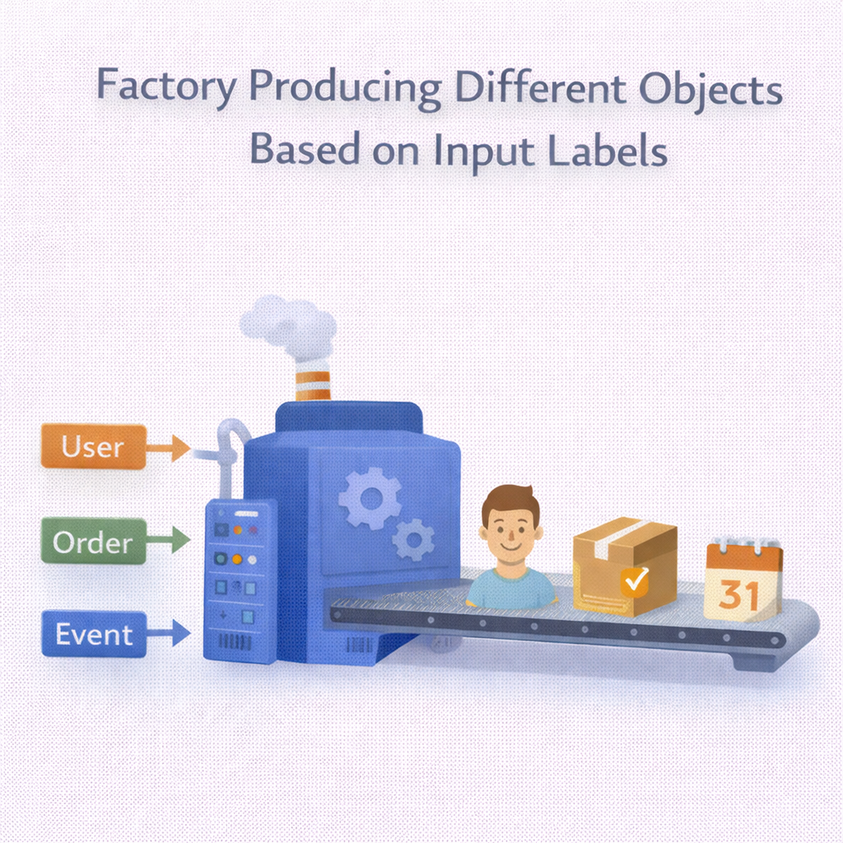
Factories
Factories centralize object creation logic.
Encapsulate complex creation logic
Return different object types
Reduce dependency on concrete classes
Improve testability
Common in scalable systems
Notes:
Explain that callers don’t need to know which class is created. Factories reduce tight coupling and conditional logic spread across code.

Slide 10
Example Python Code
class Dog:
def speak(self):
return "Bark"
class Cat:
def speak(self):
return "Meow"
def animal_factory(animal_type):
if animal_type == "dog":
return Dog()
elif animal_type == "cat":
return Cat()
animal = animal_factory("dog")
print(animal.speak())

Slide 11
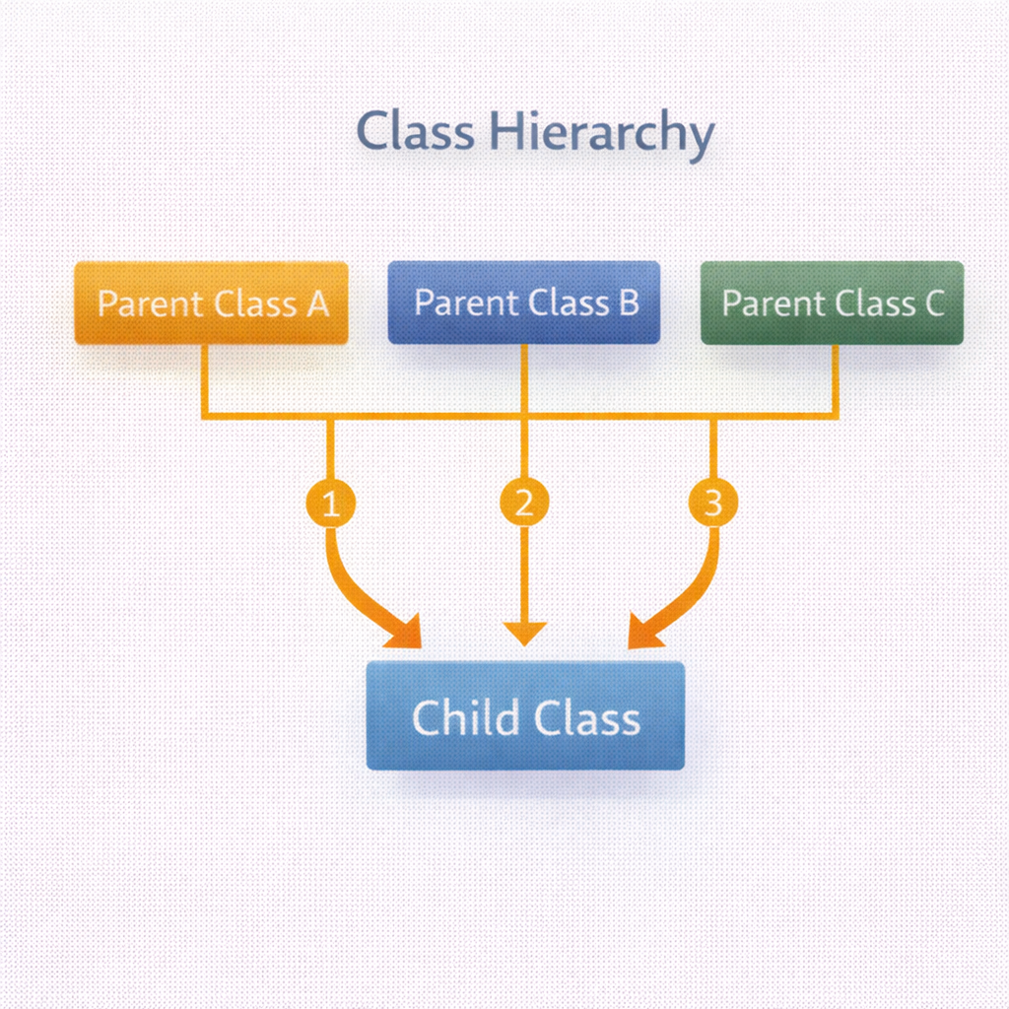
Multiple Inheritance
Multiple inheritance allows a class to inherit from more than one parent — use with care.
Python supports multiple inheritance
Method Resolution Order (MRO) defines lookup
Useful with mix-ins
Can introduce ambiguity
Prefer simplicity over cleverness
Notes:
Show how Python chooses methods using MRO. Emphasize: multiple inheritance is powerful but dangerous. Recommend using it mainly for mix-ins.

Slide 12
Example Python Code
class Duck(Flyer, Swimmer):
pass
d = Duck()
d.move()
print(Duck.__mro__)
class Flyer:
def move(self):
print("Flying")
class Swimmer:
def move(self):
print("Swimming")

